Slide 1
Unit-IV
MESSAGE AUTHENTICATION

Slide 2
CONTENT
MESSAGE SECURITY REQUIREMENTS
MESSAGE AUTHENTICATION
MESSAGE ENCRYPTION
HASH FUNCTIONS
MESSAGE AUTHENTICATION CODE (MAC)
HMAC
DIGITAL SIGNATURE
AUTHETICATION PROTOCOLS
KERBEROS
X.509 AUTHENTICATION SERVICE

Slide 3
MESSAGE SECURITY REQUIREMENTS
In communications from a computer to computer, the following attacks could be identified:
Disclosure: Release of message contents
Traffic analysis: Discovery of the pattern of traffic between parties
Masquerade: Insertion of messages into the network from a fraudulent source
Content modification: Modification of the contents of a message
Sequence modification: Modification to a sequence of messages between parties
Timing modification: Delay or replay of messages
Source repudiation: Denial of transmission of message by source
Destination repudiation: Denial of receipt of message by destination

Slide 4
MESSAGE AUTHENTICATION
Message authentication is concerned with:
Protecting the integrity of a message
Validating identity of originator
Non-repudiation of origin (dispute resolution)
Will consider the security requirements
Three alternative functions used:
Message encryption
Hash functions
Message Authentication Code (MAC)

Slide 5
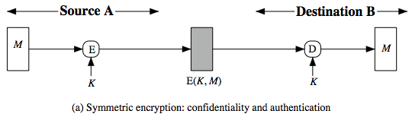
Message Encryption Symmetric Message Encryption
Encryption can also provides authentication
If symmetric encryption is used then:
Receiver know sender must have created it
Since only sender and receiver now key used
If message has suitable structure, redundancy or a checksum to detect any changes

Slide 6
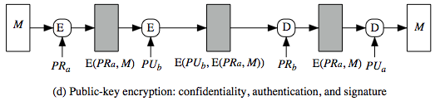
PUBLIC-KEY MESSAGE ENCRYPTION
If public-key encryption is used:
Anyone potentially knows public-key
However if
Sender signs message using their private-key
Then encrypts with recipients public key
Have both secrecy and authentication
Again need to recognize corrupted messages
But at cost of two public-key uses on message

Slide 7
HASH FUNCTIONS
Condenses arbitrary message to fixed size
h = H(M)
Usually assume hash function is public
Hash used to detect changes to message
Want a cryptographic hash function
Computationally infeasible to find data mapping to specific hash (one-way property)
Computationally infeasible to find two data to same hash (collision-free property)

Slide 8
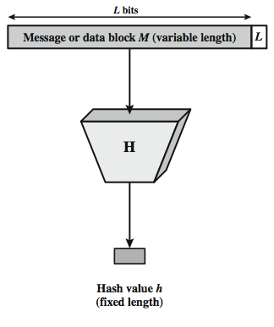
3.4.1 CRYPTOGRAPHIC HASH FUNCTION
Figure depicts the general operation of a cryptographic hash function.
The input is padded out to an integer multiple of some fixed length (e.g., 1024 bits) and the padding includes the value of the length of the original message in bits.
The length field is a security measure to increase the difficulty for an attacker to produce an alternative message with the same hash value.

Slide 9
HASH FUNCTIONS & MESSAGE AUTHENTICATION
Message authentication is a mechanism or service used to verify the integrity of a message, by assuring that the data received are exactly as sent.
Figure A, B, C and D illustrates a variety of ways in which a hash code can be used to provide message authentication, as follows:

Slide 10
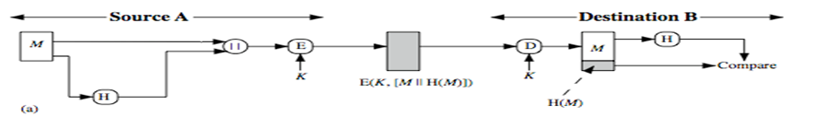
A
The message plus concatenated hash code is encrypted using symmetric encryption. Since only A and B share the secret key, the message must have come from A and has not been altered.
The hash code provides the structure or redundancy required to achieve authentication.

Slide 11
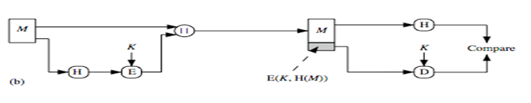
B
Only the hash code is encrypted, using symmetric encryption. This reduces the processing burden for those applications not requiring confidentiality.

Slide 12
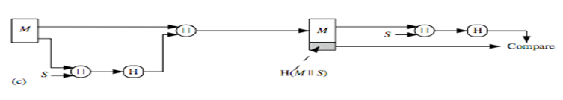
C
Shows the use of a hash function but no encryption for message authentication.
The technique assumes that the two communicating parties share a common secret value S.
A computes the hash value over the concatenation of M and S and appends the resulting hash value to M.
Because B possesses S, it can re-compute the hash value to verify.
Because the secret value itself is not sent, an opponent cannot modify an intercepted message and cannot generate a false message.

Slide 13
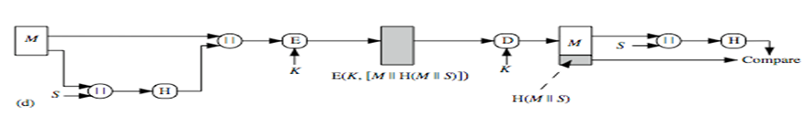
D
Confidentiality can be added to the approach of (c) by encrypting the entire message plus the hash code.

Slide 14
MESSAGE AUTHENTICATION CODE (MAC)
Generated by an algorithm that creates a small fixed-sized block
Depending on both message and some key
Like encryption though need not be reversible
Appended to message as a signature
Receiver performs same computation on message and checks it matches the MAC
Provides assurance that message is unaltered and comes from sender

Slide 15
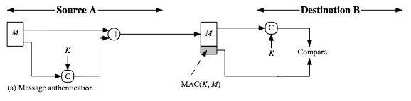
Message Authentication Code…
A small fixed-sized block of data
Generated from message + secret key
MAC = C(K,M)
Appended to message when sent
Notes:
An alternative authentication technique involves the use of a secret key to generate a small fixed- size block of data, known as a cryptographic checksum or MAC that is appended to the message. This technique assumes that two communicating parties, say A and B, share a common secret key K. When A has a message to send to B, it calculates the MAC as a function of the message and the key: MAC = C(K, M). The message plus MAC are transmitted to the intended recipient. The recipient performs the same calculation on the received message, using the same secret key, to generate a new MAC. The received MAC is compared to the calculated MAC (Stallings Figure 12.4a). If we assume that only the receiver and the sender know the identity of the secret key, and if the received MAC matches the calculated MAC, then the receiver is assured that the message has not been altered, is from the alleged sender, and if the message includes a sequence number then the receiver can be assured of the proper sequence because an attacker cannot successfully alter the sequence number. A MAC function is similar to encryption. One difference is that the MAC algorithm need not be reversible, as it must for decryption. In general, the MAC function is a many-to-one function.

Slide 16
MESSAGE AUTHENTICATION CODES
As shown the MAC provides authentication
Why use a MAC?
sometimes only authentication is needed
sometimes need authentication to persist longer than the encryption (eg. archival use)
Can also use encryption for secrecy
generally use separate keys for each
can compute MAC either before or after encryption
is generally regarded as better done before

Slide 17
MAC PROPERTIES
A MAC is a cryptographic checksum
MAC = C_{K}(M)
condenses a variable-length message M
using a secret key K
to a fixed-sized authenticator
Is a many-to-one function
potentially many messages have same MAC
but finding these needs to be very difficult

Slide 18
HMAC HMAC DESIGN OBJECTIVES
Use, without modifications, hash functions
Allow for easy re-placeability of embedded hash function
Preserve original performance of hash function without significant degradation
Use and handle keys in a simple way.
Have well understood cryptographic analysis of authentication mechanism strength

Slide 19
HMAC should execute in approximately the same time as the embedded hash function for long messages.
HMAC adds three executions of the hash compression function.
With this implementation, only one additional instance of the compression function is added to the processing normally produced by the hash function.
This is especially worthwhile if most of the messages for which a MAC is computed are short.

Slide 20
HMAC SECURITY
Proved security of HMAC relates to that of the underlying hash algorithm
Attacking HMAC requires either:
Brute force attack on key used
Birthday attack (but since keyed would need to observe a very large number of messages)
Choose hash function used based on speed verses security constraints

Slide 21
AUTHENTICATION APPLICATIONS
will consider authentication functions
developed to support application-level authentication & digital signatures
will consider Kerberos – a private-key authentication service
then X.509 directory authentication service

Slide 22
KERBEROS
trusted key server system from MIT
provides centralised private-key third-party authentication in a distributed network
allows users access to services distributed through network
without needing to trust all workstations
rather all trust a central authentication server
two versions in use: 4 & 5

Slide 23
KERBEROS REQUIREMENTS
first published report identified its requirements as:
security
reliability
transparency
scalability
implemented using an authentication protocol based on Needham-Schroeder

Slide 24
KERBEROS 4 OVERVIEW
a basic third-party authentication scheme
have an Authentication Server (AS)
users initially negotiate with AS to identify self
AS provides a non-corruptible authentication credential (ticket granting ticket TGT)
have a Ticket Granting server (TGS)
users subsequently request access to other services from TGS on basis of users TGT

Slide 25
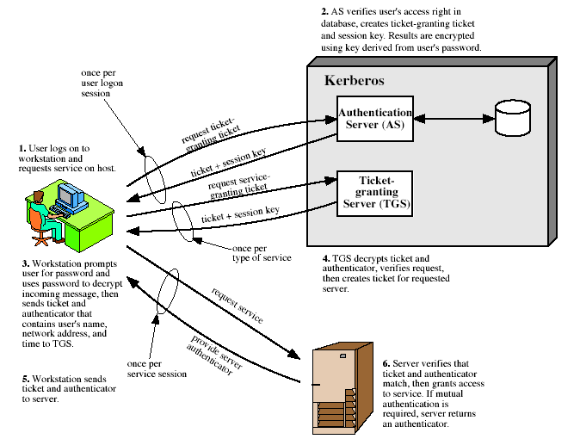
KERBEROS 4 OVERVIEW

Slide 26
KERBEROS REALMS
a Kerberos environment consists of:
a Kerberos server
a number of clients, all registered with server
application servers, sharing keys with server
this is termed a realm
typically a single administrative domain
if have multiple realms, their Kerberos servers must share keys and trust

Slide 27
KERBEROS VERSION 5
developed in mid 1990’s
provides improvements over v4
addresses environmental shortcomings
encryption alg, network protocol, byte order, ticket lifetime, authentication forwarding, interrealm auth
and technical deficiencies
double encryption, non-std mode of use, session keys, password attacks
specified as Internet standard RFC 1510

Slide 28
X.509 AUTHENTICATION SERVICE
part of CCITT X.500 directory service standards
distributed servers maintaining some info database
defines framework for authentication services
directory may store public-key certificates
with public key of user
signed by certification authority
also defines authentication protocols
uses public-key crypto & digital signatures
algorithms not standardised, but RSA recommended

Slide 29
X.509 Certificates
issued by a Certification Authority (CA), containing:
version (1, 2, or 3)
serial number (unique within CA) identifying certificate
signature algorithm identifier
issuer X.500 name (CA)
period of validity (from - to dates)
subject X.500 name (name of owner)
subject public-key info (algorithm, parameters, key)
issuer unique identifier (v2+)
subject unique identifier (v2+)
extension fields (v3)
signature (of hash of all fields in certificate)
notation CA<<A>> denotes certificate for A signed by CA

Slide 30
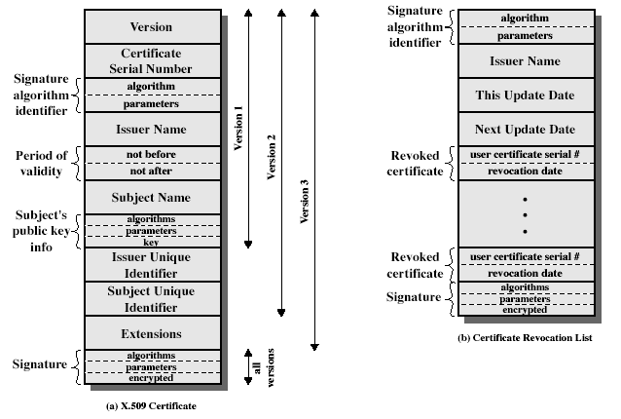
X.509 CERTIFICATES

Slide 31
OBTAINING A CERTIFICATE
any user with access to CA can get any certificate from it
only the CA can modify a certificate
because cannot be forged, certificates can be placed in a public directory

Slide 32
CA HIERARCHY
if both users share a common CA then they are assumed to know its public key
otherwise CA's must form a hierarchy
use certificates linking members of hierarchy to validate other CA's
each CA has certificates for clients (forward) and parent (backward)
each client trusts parents certificates
enable verification of any certificate from one CA by users of all other CAs in hierarchy

Slide 33
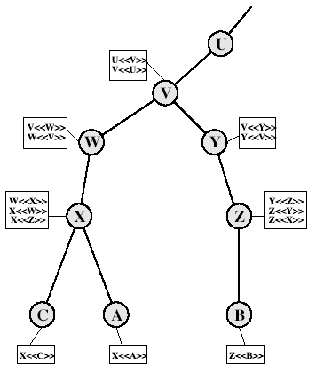
CA HIERARCHY USE

Slide 34
CERTIFICATE REVOCATION
certificates have a period of validity
may need to revoke before expiry, eg:
user's private key is compromised
user is no longer certified by this CA
CA's certificate is compromised
CA’s maintain list of revoked certificates
the Certificate Revocation List (CRL)
users should check certs with CA’s CRL

Slide 35
AUTHENTICATION PROCEDURES
X.509 includes three alternative authentication procedures:
One-Way Authentication
Two-Way Authentication
Three-Way Authentication
all use public-key signatures

Slide 36
ONE-WAY AUTHENTICATION
1 message ( A->B) used to establish
the identity of A and that message is from A
message was intended for B
integrity & originality of message
message must include timestamp, nonce, B's identity and is signed by A

Slide 37
TWO-WAY AUTHENTICATION
2 messages (A->B, B->A) which also establishes in addition:
the identity of B and that reply is from B
that reply is intended for A
integrity & originality of reply
reply includes original nonce from A, also timestamp and nonce from B

Slide 38
THREE-WAY AUTHENTICATION
3 messages (A->B, B->A, A->B) which enables above authentication without synchronized clocks
has reply from A back to B containing signed copy of nonce from B
means that timestamps need not be checked or relied upon

Slide 39
X.509 Version 3
has been recognised that additional information is needed in a certificate
email/URL, policy details, usage constraints
rather than explicitly naming new fields defined a general extension method
extensions consist of:
extension identifier
criticality indicator
extension value

Slide 40
CERTIFICATE EXTENSIONS
key and policy information
convey info about subject & issuer keys, plus indicators of certificate policy
certificate subject and issuer attributes
support alternative names, in alternative formats for certificate subject and/or issuer
certificate path constraints
allow constraints on use of certificates by other CA’s

